Slide 1
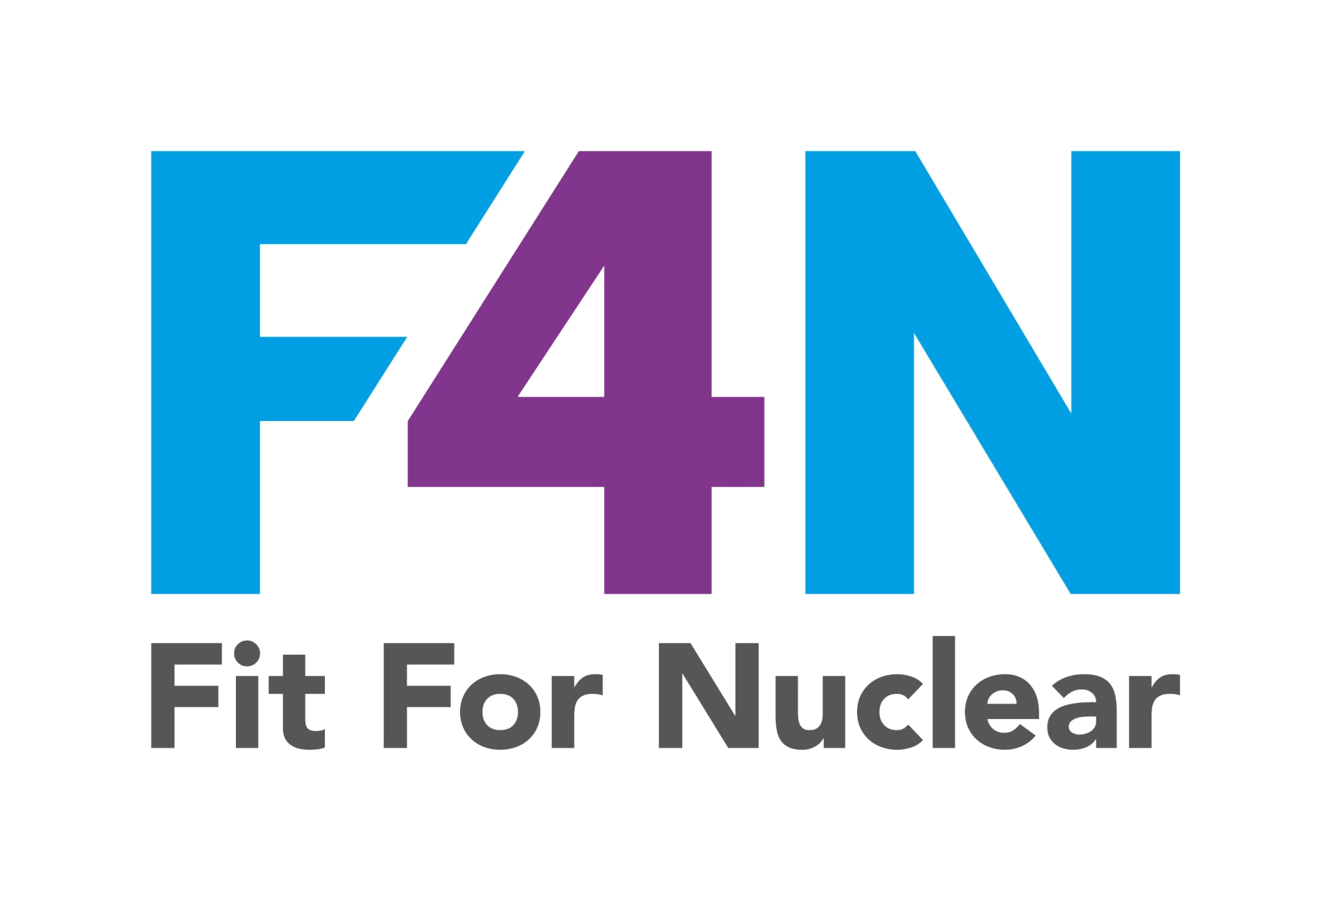







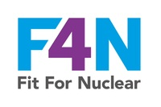
NUCLEAR SAFETY CULTURE
What it means. Why it matters. What we all need to do.
Nuclear safety culture is the collection of values, attitudes, and behaviours shared by everyone in an organisation that places nuclear safety as the overriding priority in every decision, every day, regardless of cost or schedule pressure.
Safety First
Questioning Attitude
Open Reporting
Safety is never traded against cost, time, or pressure. Every person has the authority and duty to stop work if safety is at risk.
We ask 'why' and 'what if'. We do not assume that because something has always been done a certain way it is the right way.
Near misses and concerns are reported without fear. We learn from what goes wrong and what nearly went wrong.
Personal Accountability
Visible Leadership
Continuous Learning
Every individual takes responsibility for the quality and safety of their own work. We do not pass problems to others.
Leaders demonstrate nuclear safety in their own behaviour. They are present, they ask questions, and they act on what they find.
We actively seek to improve. We share lessons, benchmark ourselves, and never consider our safety culture to be finished.
NucCol | Nuclear Collaboration Ltd · Fit For Nuclear Programme · Commercial in Confidence | 1

Slide 2
WHAT DOES GOOD NUCLEAR SAFETY CULTURE LOOK LIKE?
Observable behaviours we should see every day in our organisation
Leadership
Individuals
Systems
Leaders carry out regular safety walks and record what they find
Staff follow procedures without being reminded or supervised
Non-conformances are recorded, investigated, and closed formally
Safety topics appear on every senior management meeting agenda
Near misses and concerns are raised promptly and without hesitation
Training records are current and accurately reflect actual competence
Leaders respond to concerns raised by staff quickly and visibly
People ask questions when they are unsure rather than making assumptions
CFSI checks are carried out at goods receipt as a matter of routine
Directors can explain the company's nuclear safety commitments in their own words
No one signs off work they are not fully satisfied with
Lessons from incidents and near misses are communicated to the team
NucCol | Nuclear Collaboration Ltd · Fit For Nuclear Programme · Commercial in Confidence | 2

